Slide 1
Dublin Data Visualisation Meetup
#DublinDataVis (21st MAy 2013)

Slide 2

Why did we Create this meetup?
A community for those interested in creating, sharing, discussing or learning how to create data-driven visualisations.
Fighting the good fight against a massive data deluge.

Slide 3
Events we’d like to host
Walkthroughs (like this one)
Short sharing sessions
Discussions on technologies
Visualisation ‘Cook-Off’ (for fun!)
Share Neat Visualisations
Share Visualisation Stories (when it worked / why it worked)

Slide 4
Create rich interactive data visualisations
Eamonn O’Loughlin
#DublinDataVis (21st MAy 2013)

Slide 5
Eamonn O’Loughlin
6 years as Management Consultant / Analytics Consultant
Developing / implementing insight-generating solutions (customer segmentation, loss-default forecasting, business event simulation, operations strategy)
Researching behaviour through the lens of Social Network Analysis (Dynamics Lab at UCD)
Interested in visualisation of dynamic social networks, algorithms, web application frameworks, mobile device interaction, collaboration technologies
@ieeamo / http://www.linkedin.com/in/eamonnoloughlin

Slide 6
Rich Interactive Visualisations
Accessible in browser
Interactive
Scalable to moderate-sized datasets (~1M rows)
Easy / Quick to Implement
Flexible
Enables Rapid Prototyping
Encourages Data Exploration

Slide 7
What today is not about
Enterprise Solution
Scalable to ‘Big Data’
Unique Visualisations
Extensive Customisation

Slide 8
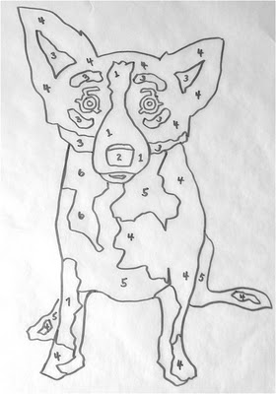
What we’re going to do
Quick Review of underlying components
Download a dataset
Explore the Data Structure
Design our Visualisation (Rough Plan)
Iteratively Implement our Visualisation*
Tidy and Wrap Up
*This is the hardest part

Slide 9
What we’re going to do
Quick Review of underlying components
Download a dataset
Explore the Data Structure
Design our Visualisation (Rough Plan)
Iteratively Implement our Visualisation
Tidy and Wrap Up

Slide 10
Today we will be using
Web Server
dc.js
Bootstrap
Note: dc.js is built on top of d3.js and crossfilter.js
(so we will only be using these indirectly)

Slide 11
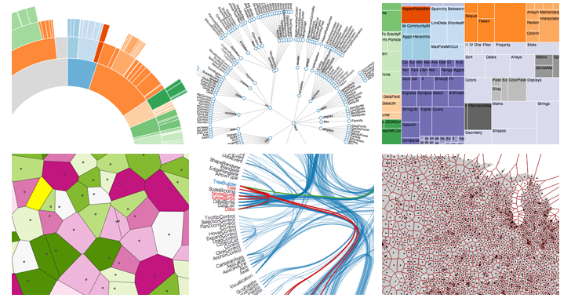
D3.js
“D3.js is a JavaScript library for manipulating documents based on data. D3 helps you bring data to life using HTML, SVG and CSS. D3’s emphasis on web standards gives you the full capabilities of modern browsers without tying yourself to a proprietary framework, combining powerful visualization components.”
Developed by Mike Bostock (Graphic Editor of New York Times)

Slide 12
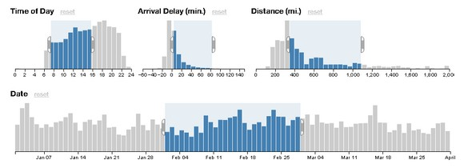
Crossfilter.js
“Crossfilter is a JavaScript library for exploring large multivariate datasets in the browser. Crossfilter supports extremely fast (<30ms) interaction with coordinated views, even with datasets containing a million or more records.”
Built to power analytics for Square Register, allowing merchants to slice and dice their payment history fluidly.

Slide 13
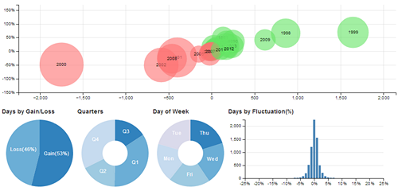
DC.js
“dc.js is a javascript charting library with native crossfilter support and allowing highly efficient exploration on large multi-dimensional dataset. It leverages d3 engine to render charts in css friendly svg format.”
Developed by Nick Qi Zhu at Thoughtworks to perform data visualization and analysis in browser as well as on mobile device

Slide 14

Bootstrap
“Sleek, intuitive, and powerful front-end framework for faster and easier web development. Bootstrap was made to not only look and behave great in the latest desktop browsers, but in tablet and smartphone browsers via responsive CSS as well.”
Developed by a team at Twitter.

Slide 15
What we’re going to do
Quick Review of underlying components
Download a dataset
Explore the Data Structure
Design our Visualisation (Rough Plan)
Iteratively Implement our Visualisation
Tidy and Wrap Up

Slide 16
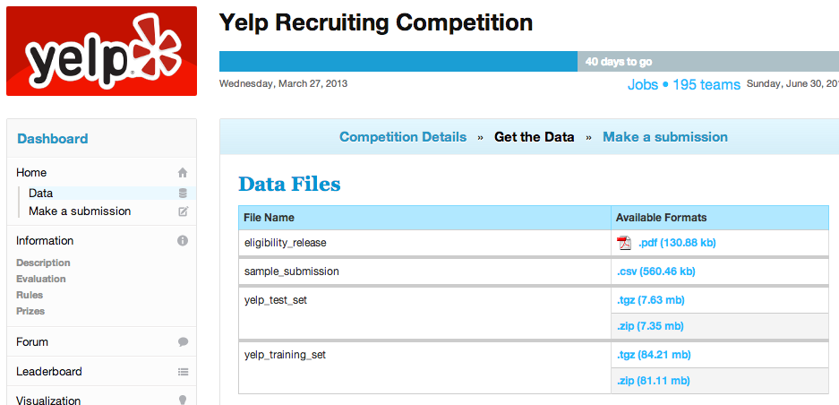
YELP KAGGLE CHallenge
Download the yelp test set

Slide 17
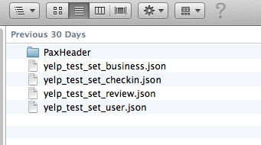
YELP KAGGLE CHallenge
yelp_test_set_business.json

Slide 18
What we’re going to do
Quick Review of underlying components
Download a dataset
Explore the Data Structure
Design our Visualisation (Rough Plan)
Iteratively Implement our Visualisation
Tidy and Wrap Up

Slide 19
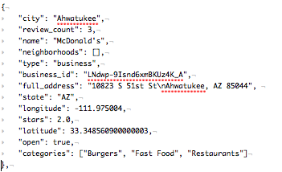
DATA Structure

Slide 20
What we’re going to do
Quick Review of underlying components
Download a dataset
Explore the Data Structure
Design our Visualisation (Rough Plan)
Iteratively Implement our Visualisation
Tidy and Wrap Up

Slide 21
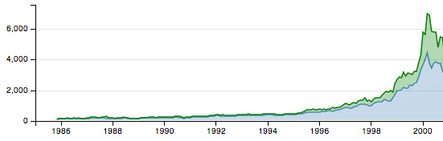
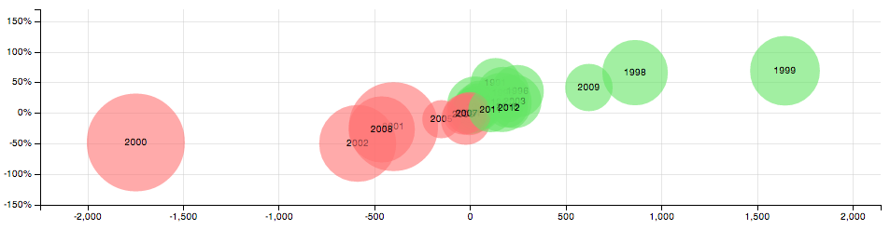
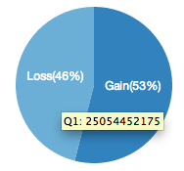
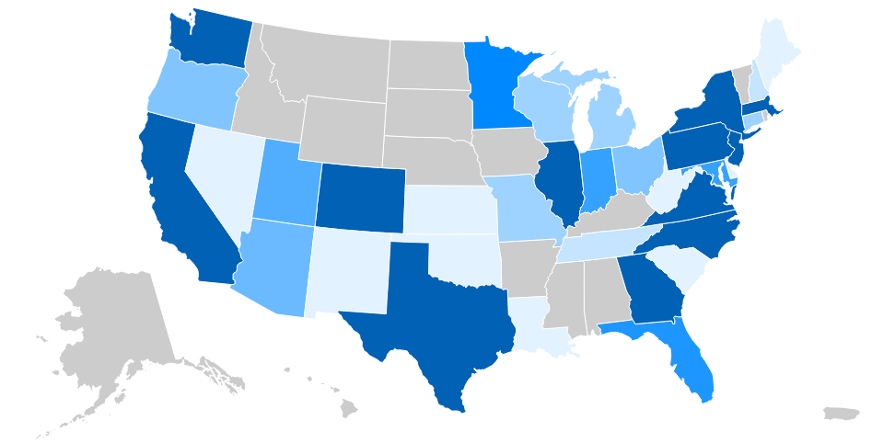
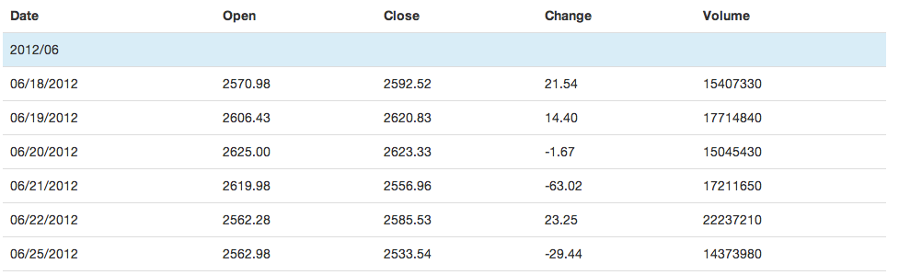
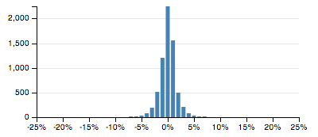
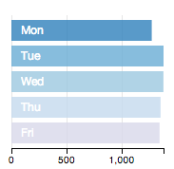
dc.Js library
Line Chart
Bubble Chart
Data Table
Pie Chart
Choropleth Map
Bar Chart
Row Chart

Slide 22
Design our Visualisation

Slide 23
What we’re going to do
Quick Review of underlying components
Download a dataset
Explore the Data Structure
Design our Visualisation (Rough Plan)
Iteratively Implement our Visualisation
Tidy and Wrap Up

Slide 24
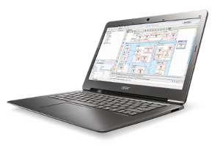


Implementation
3 Stages to Implement
Development Environment
HTML
JavaScript
+
+

Slide 25
Simple step-by-step approach
Development Environment
In a new folder create index.html, simple_vis.js
Copy yelp data and components (js/css) into folder
Start web server (mongoose) from folder
Open browser to url localhost:8080
Open javascript console
Notes:
python -m SimpleHTTPServer 8080 / python -m http.server 8080

Slide 26
Simple step-by-step approach
HTML
Setup simple structure
<head>
<body>
Load javascript libraries (d3, crossfilter, dc)
Load stylesheets (dc)
Setup <div> placeholders

Slide 27
Simple step-by-step approach
JavaScript (datavis.js)
Load Data
Create Chart Object(s)
Run Data Through Crossfilter
Create Data Dimensions & Groups
Implement Charts
Render Charts

Slide 28
Segway #1 Dimensions / Groups
Dimension
Returns ordered (and cached) data based on selected variable from the underlying data
Group
Return aggregation of the data, based on chosen dimension. Typical examples include:
ReduceSum (sum the values)
ReduceCount (count of items)
Reduce (custom) – describe what happens aggregation when items are added / removed from group

Slide 29
Segway #2 Chaining
Majority of dc functions are designed to allow function chaining, meaning it will return the current chart instance whenever it is appropriate.
Therefore configuration of a chart can be written in the following style:
myChart.width(300)
.height(300)
.filter("sunday");

Slide 30
What we’re going to do
Quick Review of underlying components
Download a dataset
Explore the Data Structure
Design our Visualisation (Rough Plan)
Iteratively Implement our Visualisation
Tidy and Wrap Up

Slide 31
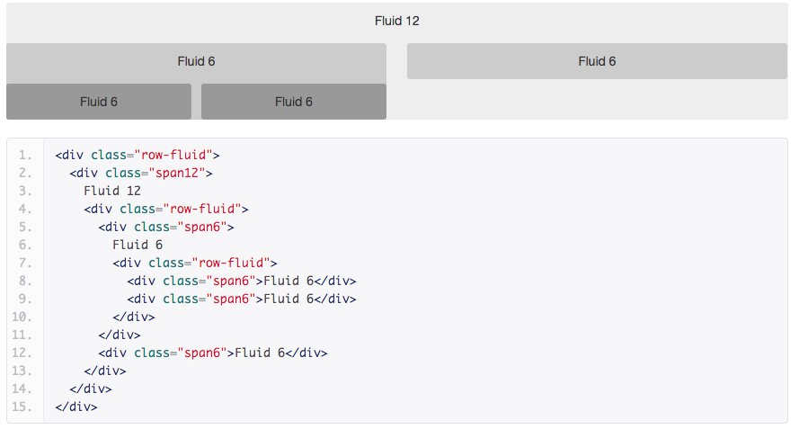
Segway #3 Bootstrap fluid Nesting

Slide 33

That’s IT. Thank You
Blue Dog Images from blog of Wendy Rodrigue

Slide 34
That’s IT. Thank You
What questions / comments do you have?
Blue Dog Images from blog of Wendy Rodrigue

